Slide 1
607MAN 303MAN Strategic Leadership
Introduction and Module Overview
Week 1 – Session 1

Slide 2
Module Tutors
Marion Greenhalgh – ab8681@coventry.ac.uk
Bhajan Aulak - aa6097@coventry.ac.uk

Slide 3



What we’re going to cover today…
(1)
Module Overview
(2)
Module Assessments
(3)
Strategic Leadership

Slide 4
Module Overview

Slide 5
Aims and Summary
The module examines the knowledge, skills, behaviours and techniques of effective leadership and explores the role of leadership in relation to business themes such as globalisation, strategy, innovation and organisational development.
Students will be expected to prepare themselves to address contemporary leadership issues such as managing virtual teams and corporate social responsibility (CSR).
The question of ethics will be explored in each of the themes in this module – recognising how this topic underpins the leadership in business debate.

Slide 6
Aims and Summary
Students will be encouraged to contrast practices from leading organisations and leaders.
Students will have the opportunity to debate and develop key leadership skills to support their personal career development.
Students will be encouraged to use a range of tools to raise their self- awareness, as well as gather peer and tutor feedback to inform their current strengths and inform their on-going professional development as a future manager or organizational leaders.

Slide 7
Intended Module Learning Outcomes
Evaluate and apply conceptual and practical approaches to strategic leadership in a range of different organisational settings.
Analyse contemporary research on the role of leadership in managing change in the wider commercial environment.
Critically assess the relevance of leadership styles to key sector changes including globalisation, internationalisation, strategy, technological innovation and organisation development.
Identify and critically reflect on leadership capabilities, styles and strategies of key Business leaders across a range of sectors reflecting strategic shifts in the business environment.
Evaluate an example of strategic organisational change by exploring the role of leadership and the measurement and management of Key Performance Indicators (KPI’s) in a range of settings.
Critically explore the ethical relationships between leaders and followers in relation to decision making, corporate governance and policy practices in organisations relating to business change.

Slide 8

Module Books
Essential Reading
Lynch, R., (2021) Strategic Management. 9th edn. London: Pearson Education
Yukl, G. (2020), Leadership in Organizations: Global Edition. 9th edn. Los Angeles: SAGE
Recommended Reading
Robbins, S.P., De Cenzo, D.A., Coulter, M. (2020) Fundamentals of Management: Management Myths Debunked! Global Edition. 11th edn. Harlow: Pearson
Johnson, G., Whittington R., Scholes K. (2020) Exploring Strategy: Texts and Cases. 12th edn. Harlow: Pearson.
Huge range of related journal articles available through Locate.

Slide 9
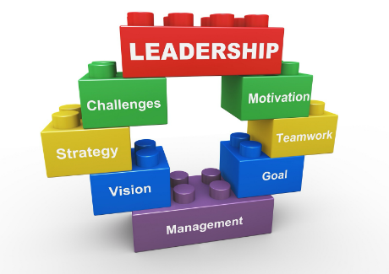
Topics to be covered Week 1
Module Introduction - Strategic Leadership
Strategic Management
A review of Theory and Practice
Analysing the Strategic Environment in a Global context

Slide 10

Topics to be covered Week 2
Analysing strategic resources and capabilities
Managing strategic change
Organisational structure, style and people issues
Power and authority in organisations

Slide 11
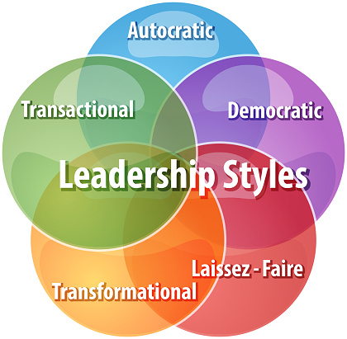
Topics to be covered Week 3
Leadership styles
Entrepreneurial leader
Leadership and followership
Gender, diversity and ethics

Slide 12
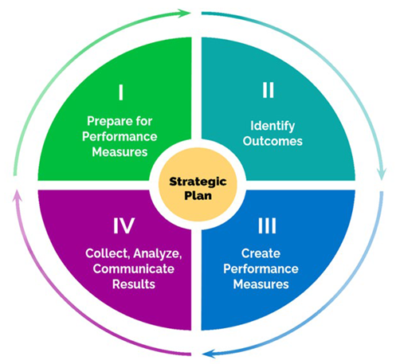
Topics to be covered Week 4
Strategy dynamics
Developing the purpose of the organisation
Creating and benefiting from an innovative purpose
Performance measurement

Slide 13

Topics to be covered Week 5
Developing a customer driven strategy
Developing business strategy options
Choosing between strategy options
Entrepreneurial strategy

Slide 14

Topics to be covered Week 6
Bringing the strategic management elements together
Global and cross-cultural leadership

Slide 15




Method of Assessment 303MAN
Assessment 1:
1000-word report & 10 minute video presentation (40%)
Week 3
Assignment 2:
4000-word report (60%)
Week 6
607MAN
Assignment 1:
4500-word report (100%)
Week 6

Slide 16
Class Discussion
What is your current understanding of leadership?
Are you aware of any leadership concepts/theories?
How has leadership evolved over generations?

Slide 17
Strategic Leadership

Slide 18
What we’ll be looking at
What is strategic leadership?
What makes a successful leader?
How leaders shape organisational style and culture
How leaders cope with power
Successful strategic leadership

Slide 19


Report
Explain it:
15 minutes
In you have 15 minutes to research what is a strategic leader?
Be prepared to report back to the class...

Slide 20
What is Strategic Leadership?
Strategic leadership is the ability to shape the organisation’s decisions and deliver high value over time, not only personally but also by inspiring and managing others in the organisation.
Leadership involves balancing a number of factors relating to strategy:
outside influences that impact on the organisation from changes in the economy to increased competition.
Inspiring and leading people inside the organisation with a clear direction for its future.

Slide 21
What makes a successful leader?
Role of leadership: “The art or process of influencing people so that they will strive willingly and enthusiastically toward the achievement of the group’s mission.”
Assess particularly:
Need to inspire the organisation
Need to reflect and support employees
Strategic need to take tough decisions, e.g. in failing business
Balance between control and entrepreneurial styles
Leadership style: varies from shared vision to dominant

Slide 22
Traits / Characteristics / Features / Qualities
Loyalty- demonstrate loyalty to their vision by their words and actions
Keeping them updated- what is happening within their organization through formal and informal sources
Judicious use of power- try to develop consent for their ideas rather than forcing - Gradual push of ideas
Have wider perspective/outlook- Strategic leaders may be specialists but also a little knowledge about a lot of things.
Motivation- beyond money and power – inclined to achieve goals with energy and determination.
Compassion- understand the views and feelings of their subordinates, and make decisions after considering them

Slide 23
Traits / Characteristics / Features / Qualities
Readiness to delegate and authorize- delegation will avoid overloading of responsibilities. Authorizing and empowering subordinates to make decisions will motivate and empower.
Articulacy- Strong leaders are articulate enough to communicate the vision(vision of where the organization should head) to the organizational members in terms that boost those members
Constancy/ Reliability- Strategic leaders constantly convey their vision until it becomes a component of organizational culture
Self-control- control distracting/disturbing moods and desires, i.e., think before acting.
Social skills- strategic leaders must be friendly and social.
Self-awareness- understand their own moods and emotions, as well as their impact on others.

Slide 24
Leadership Theories
Three main theories:
Trait theories: individuals with certain characteristics (traits) can be identified, will provide leadership most situations – the ‘born’ leader
Style theories: those who possess a general style of leadership that is appropriate to the organisation – the ‘dominant style leader,’ the ‘consultative style’ leader and so on.
Contingency theories: leaders should be promoted or recruited according to the needs of the organisation at a particular point in time. The choice is contingent on the strategic issues facing the organisation at that time.

Slide 25
Leadership Theories
From a strategic perspective, the contingency theory approach holds the most scope for two reasons:
Best captures both the leader and the relationship with others in the organisation
Best reflects that the strategic context is highly relevant to leadership decision making
Within the contingency theory context, the best-fit approach argues that leaders, subordinates and strategies must reach a compromise if they are to be successful

Slide 26
Leadership Styles
Factors influencing successful leadership style:
Personality and skills of leader
Size of company
Degree of geographical dispersion
Stability of organisation’s environment
Current organisational culture
Organisation’s current profitability and its desire and need for change

Slide 27
What makes a successful leader?
Bennis and Nanus (1985) argue that successful leaders need to go beyond abstract analytical areas to
Generate trust in the organisation’s processes
Draw upon the intellectual capital of people in the organisation
Demonstrate a passion and determination to achieve the purposes of the organisation

Slide 28
Leadership Culture

Slide 29
Shaping Organisational Culture and Style
Organisational culture: “The way we do things around here…”
As you walk into the entrance of the organisation, you can immediately sense something of its culture…
Culture: Leadership and people, the ‘buzz’, the formality/informality, how people talk to each other, relate to each other and so on…
Leaders have a major influence in organisational culture over time but cultures only change slowly

Slide 30
Shaping organisational culture and style
Leaders are concerned with shaping the culture of their organisations over time
Leaders should distinguish between the culture of their organisations and national cultures: national cultures may influence their organisations but they are not the main influence
Leaders can analyse their organisation’s culture through:
History and ownership
Size
Leadership and mission
Types of organisational cultural style

Slide 31
Shaping Organisational Culture and Style
People, corporate cultures, labour policies, international issues.
Environment
History? Size?
Products and technology?
Leadership?
Business context?
Cultural factors specific to
organisation
Identification of cultural style of the organisation
Power? Role?
Task? Personal?
Prescriptive or emergent?
Competitive advantage?
Able to undertake strategic change?
Analysis of the strategic implications
Notes:
See: Lynch Ch 16

Slide 32
Shaping Organisational Culture and Style (Johnson and Scholes 1992)
Symbols: what are the signs within the office?
Cultural Web
Stories: what do people talk about?
Power structures: who makes the decisions?
The Paradigm
Routines and Rituals: how are things done?
Control systems: bureaucratic? Performance oriented?
Organisational structure: who reports to whom?

Slide 33
Shaping Organisational Culture and Style
Charles Handy (1999) argues that there are four main organisational cultural styles:
Power: organisation revolves around/dominated by individual or a small group
Roles: the organisation relies on committees, structures, logic and analysis
Task: the organisation is geared to tackling identified projects or tasks. Work is undertaken in teams that are flexible and tackle identified issues
Personal: the individual works and exists purely for him/herself.

Slide 34
What makes a Successful Leader? - 5
Bennis and Nanus (1985) argue that successful leaders need to go beyond abstract analytical areas to
Generate trust in the organisation’s processes
Draw upon the intellectual capital of people in the organisation
Demonstrate a passion and determination to achieve the purposes of the organisation

Slide 35
Sustaining competitive advantage over time
Successful Strategic Leadership: 5 Main Elements - 1
Developing and communicating the organisation’s purpose
Managing human resource and organisation decisions
Defining and delivering to stakeholders
Setting ethical standards
Notes:
Developing and communicating the organisation’s purpose
Managing human resource and organisation decisions
Sustaining competitive advantage over time
Defining and delivering to stakeholders
Setting ethical standards
Prime task of leader: to determine the organisation’s purpose and then communicate this to every part of the organisation
Leaders need to select, nurture and develop employees, especially key talents
Leaders responsible for motivating and rewarding employees
Key leadership task: set and monitor the ethical and corporate social responsibility standards of the organisation
These values must come from the top of the organisation
Leaders must maintain good relationships with stakeholders both inside and outside the organisation
Typically, many demands on the leader’s time and resource, so leaders must judge how to manage this
Outside advisers increasingly common in providing help
Leaders are responsible for preserving and enhancing the competitive advantage of their organisations
Leaders need to identify and support such advantages

Slide 36
What we’ve covered today…
(1)
Module Overview
(2)
Module Assessments
(3)
Strategic Leadership

Slide 37

Traffic Light it
Where is your learning at?
Red = I have misunderstood some of the topics. (write down 2 questions that you need help with)
Amber = I have understood most of the topics so far (write down 1 question and 1 key theme you have understood)
Green = I have understood the topics so far (write down 2 key themes from the lesson to show your understanding)

Slide 38
Reading list
Essential Reading
Lynch, R., (2021) Strategic Management. 9th edn. London: Pearson Education
Yukl, G. (2020), Leadership in Organizations: Global Edition. 9th edn. Los Angeles: SAGE
Recommended Reading
Robbins, S.P., De Cenzo, D.A., Coulter, M. (2020) Fundamentals of Management: Management Myths Debunked! Global Edition. 11th edn. Harlow: Pearson
Johnson, G., Whittington R., Scholes K. (2020) Exploring Strategy: Texts and Cases. 12th edn. Harlow: Pearson.

